Slide 1














MOCK EMBEDDED PROJECT
THE DIGITAL CLOCK
TRAN QUANG NGUYEN ANH
PHAM DUONG QUYNH

Slide 2

CONTENTS
1.MOCK Embedded The Digital Clock
2.Architecture design
3.Sequence Diagram
4.Detail design
5.How to execute
(Intruction Manual)

Slide 3
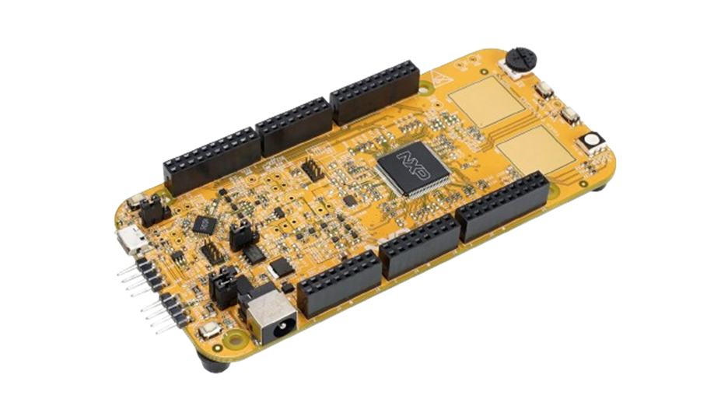
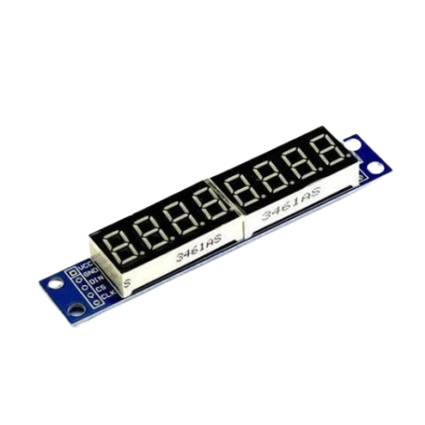
1.The Digital Clock
SRS 1: Ater power on, display the time: 00-00-00 (date: 00.00.0000
SRS 2: Press Button PTC12
- SRS 2-1: Display the date
- SRS 2-2: Display the time
SRS 3: Press Button PTC13
- SRS 3-1: Turn off the display mode
- SRS 3-2: Turn on the display mode
SRS4: Setting date, time by UART serial communication

Slide 4

HARDWARE

Slide 5
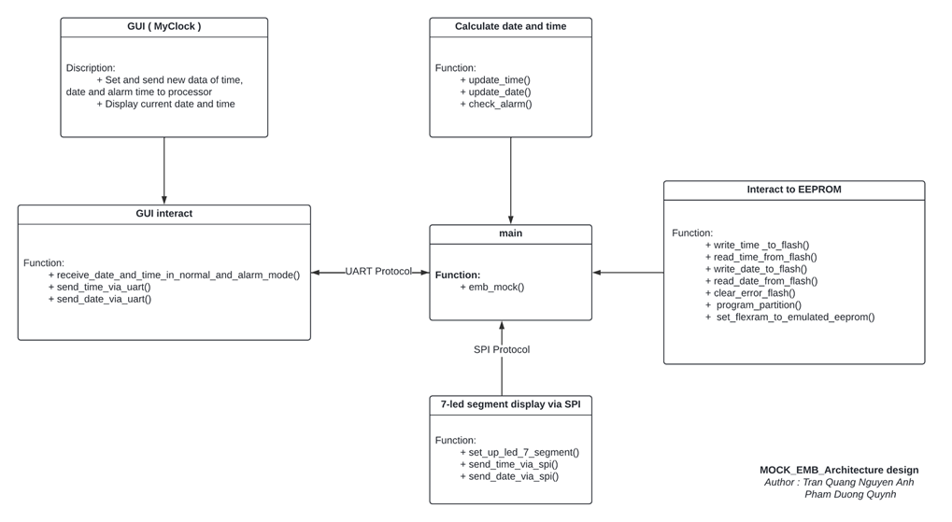
2.Architecture design

Slide 6
3.Sequence Diagram
File : THE DIGITAL CLOCK - ARCHITECTURE AND DETAIL DESIGN

Slide 7
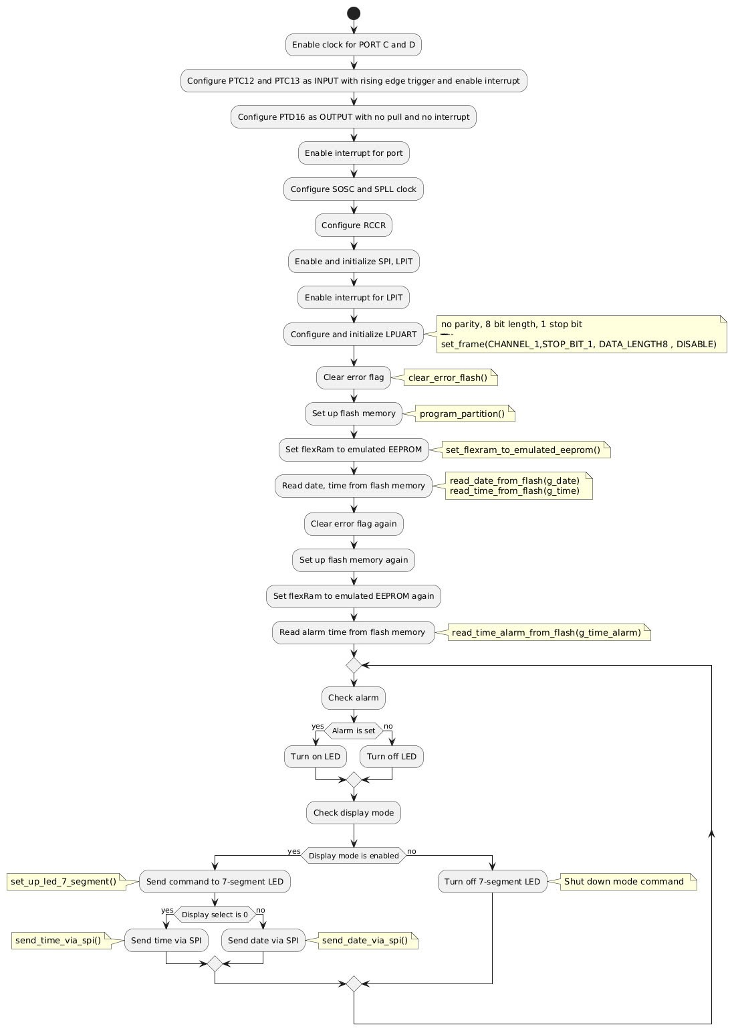
4.Detail design
emb_mock()

Slide 8
4.Detail design

Slide 9
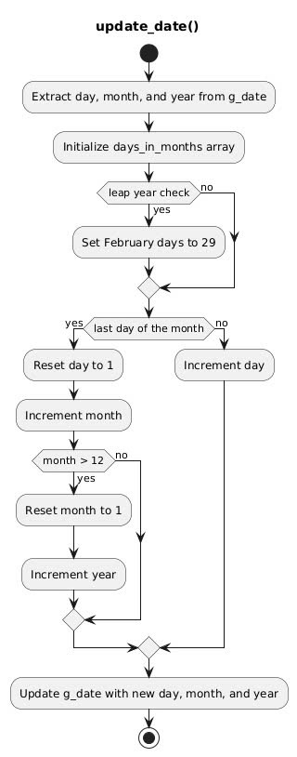
4.Detail design

Slide 10
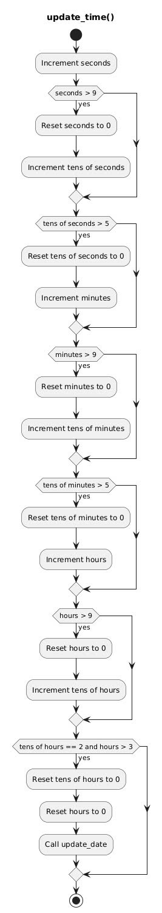
4.Detail design

Slide 11
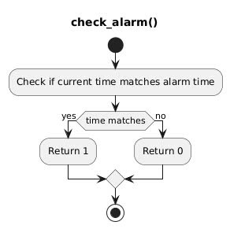
4.Detail design

Slide 12
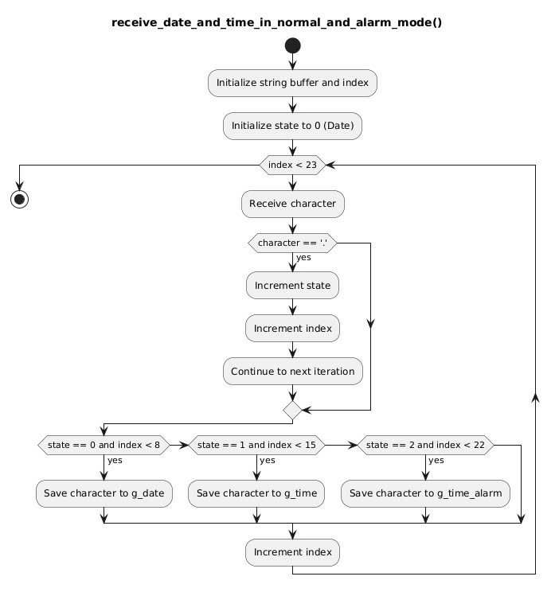
4.Detail design

Slide 13
4.Detail design

Slide 14
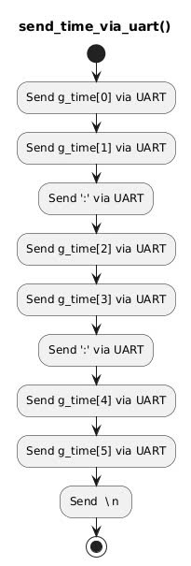
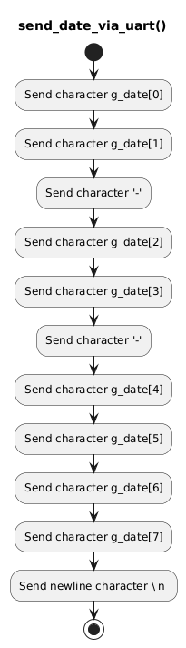
4.Detail design

Slide 15
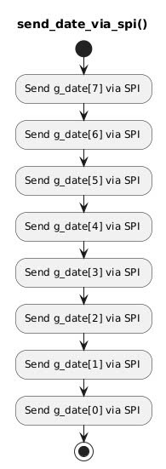
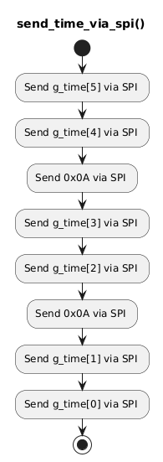
4.Detail design

Slide 16
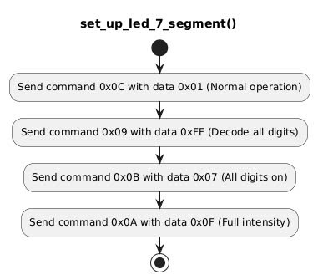
4.Detail design

Slide 17
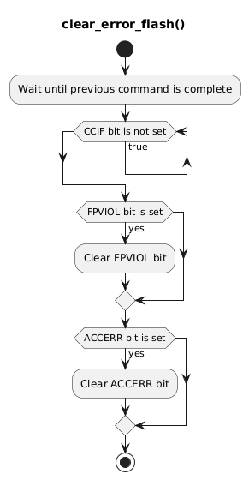
4.Detail design

Slide 18
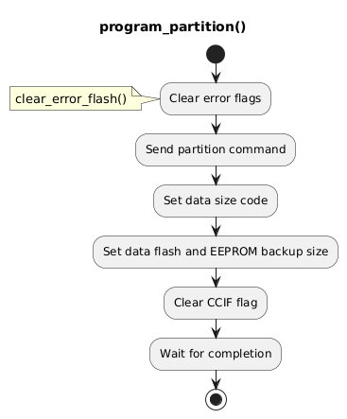
4.Detail design

Slide 19
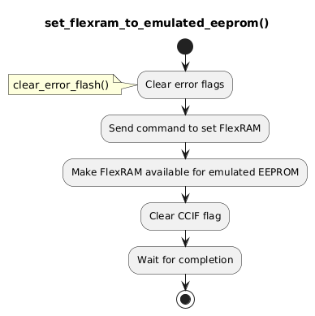
4.Detail design

Slide 20
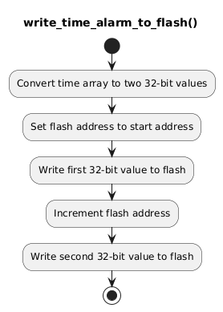
4.Detail design

Slide 21
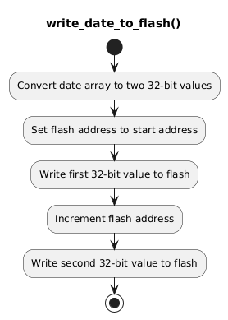
4.Detail design

Slide 22
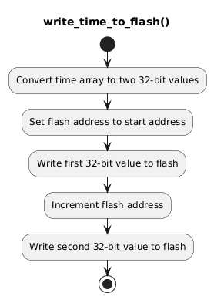
4.Detail design

Slide 23
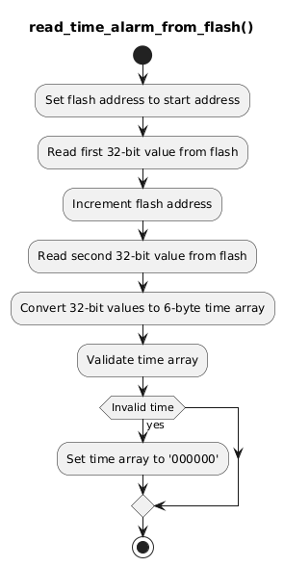
4.Detail design

Slide 24
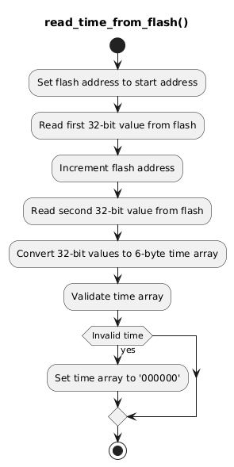
4.Detail design

Slide 25
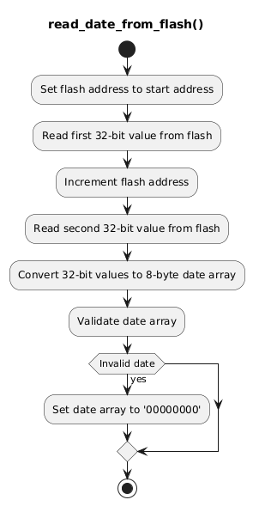
4.Detail design

Slide 26
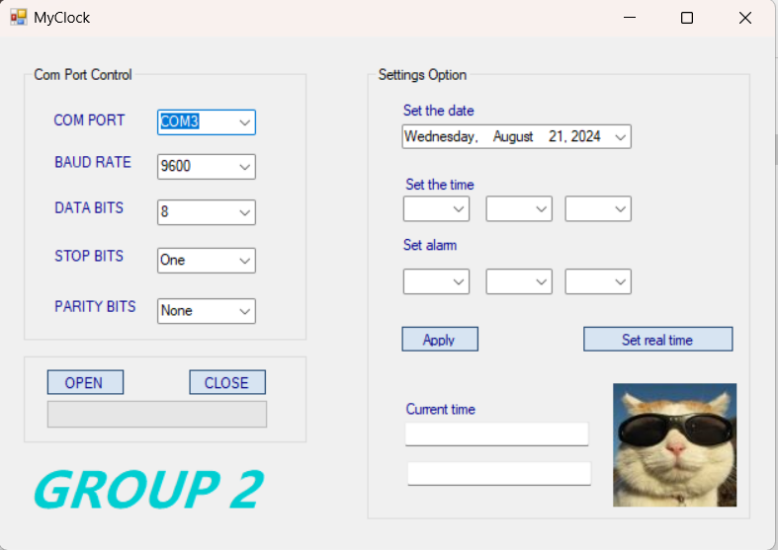
5.How to execute (Intruction Manual)

Slide 27
THANK YOU VERY MUCH!

